Slide 1

Fusion of Deep Learning Features with Mixture of Brain Emotional Learning for Audio-Visual Emotion Recognition
125015103 Samatha A
125015120 Srividhya S
125015111 Shahana S
Dr. Emily Jenifer A (AP III / SoC )

Slide 2
INDEX
Objective
Base Paper
Problem Statement
Literature Survey
Dataset
WorkFlow
Modules
Work Done
Reference

Slide 3
OBJECTIVE
To address the spatial-temporal correlations in video content, recognizing the intricate patterns of emotion expressed through both audio and visual cues.
To extract highly abstract features from audio and visual data using Deep learning algorithms like CNN and RCNN.
To come up with an Efficient approach to detect Human emotions with higher accuracy.

Slide 4
BASE PAPER
Farhoudi, Z., & Setayeshi, S., (2021). Fusion of deep learning features with mixture of brain emotional Learning for audio-visual emotion recognition. Speech Communication, 127, 92-103.
In this paper, a fusion model combining deep learning features with a Mixture of Brain Emotional Learning model inspired by the brain's limbic system is Introduced.

Slide 5
PROBLEM STATEMENT
To detect Emotions from Video Clips using Fusion of video and Audio modalities.

Slide 6
LITERATURE SURVEY
S.NO 1 2 3
TITLE OF THE ARTICLE | AUTHORS | METHODOLOGY | YEAR | ACCURACY
Learning Affective Features With a Hybrid Deep Model for Audio–Visual Emotion Recognition | Shiqing Zhang1, Shiliang Zhang1, Tiejun Huang1, Wen Gao1, Qi Tian2 | CNN, 3D-CNN, and DBN on eNTERFACE’05 dataset | 2018 | 78.08%
Wavelet Fuzzy Brain Emotional Learning Control System Design for MIMO Uncertain Nonlinear Systems. | Jing Zhao1, Chih-Min Lin2, Fei Chao3 | wavelet fuzzy brain emotional learning controller (WFBELC) model, fuzzy theory, and brain emotional neural network | 2019 | Solved using Mathematical equations
Audio–visual affective expression recognition through multi stream fused HMM | Z Zeng, J Tu, BM Pianfetti, TS Huang | Multistream fused Hidded Markov Model (MFHMM) | 2008 | 80.61%

Slide 7
4
5
6
7
8
Learning Spatiotemporal Features with 3D Convolutional Networks | Du Tran Lubomir Bourdev; Rob Fergus; Lorenzo Torresani; Manohar Paluri | 3D Convolutional Neural Network on UCF101 dataset | 2015 | 52.8%
Speech Emotion Recognition using Convolutional and Recurrent Neural Networks | Wootaek Lim, Dae-young Jang, Taejin Lee | Concatenated CNN and RNN | 2016 | 86.65%
Deep Learning Based Audio-Visual Emotion Recognition in a Smart Learning Environment | Natalja Ivleva, Avar Pentel, Olga Dunajeva & Valeria Juštšenko | Convolution Neural Network | 2023 | 81.05%
Human Emotion Recognition by Optimally Fusing Facial Expression and Speech Feature | Xusheng Wang, Xing Chen, Congjun Cao | LSTM-CNN for speech emotion recognition, CNN-RNN for facial emotion recognition | 2020 | around 95%
Human Emotion Recognition System Using Deep Learning Algorithms | K Yuvchenko, V Yesilevskyi | Image Classification method based on a densely connected convolutional neural network | 2022 | studied the working of Algorithms

Slide 8
9
10
11
Emotion Recognition in Public Speaking Scenarios Utilising An LSTM-RNN Approach with Attention | Alice Baird; Shahin Amiriparian; Manuel Milling; Björn W. Schuller | Long Short-Term Memory - Recurrent Neural Network (LSTM-RNN) architecture with a self-attention layer | 2021 | 89%
Human Emotion Recognition Based on Facial Expressions via Deep Learning on High Resolution Images | Yahia Said & Mohammad Barr | FS-CNN,Tensor low deep learning with CUDA On custom dataset | 2021 | detection accuracy of about 93% and a recognition accuracy of about 95%
AAD-Net: Advanced end-to-end signal processing system for human emotion detection & recognition using attention-based deep echo state network | Mustaqeem Khan ª, Abdulmotaleb El Saddik ª, Fahd Saleh Alotaibi ^{b}, Nhat Truong Pham | Deep Echo-State-Network (DeepESN),dilated convolution neural network and multi-headed attention mechanism. | 2023 | 78.5%

Slide 9
12
Disruptive situation detection on public transport through speech emotion recognition | Eleonora Mancini, Andrea Galassi, Federico Ruggeri, Paolo Torroni | Support Vector Machines (SVMs) Convolutional Neural Networks (CNNs), Long-Short Term Memory Networks (LSTMs) and Hidden Markov Models (HMMs) | 2024 | 86.7%

Slide 10
DATASET
The Ryerson Audio Visual Database of Emotional Speech and Song(RAVDESS) is used in this Project
The dataset contains 24 professional actors(12 male and 12 female)
The RAVDESS dataset contains 7356 files in 3 modality formats-Audio only , Video only , Audio video.
It contains data for 6 emotions such as Calm , Happy , Sad, Angry, Fear, Neutral.
Link to dataset: https://zenodo.org/records/1188976

Slide 11
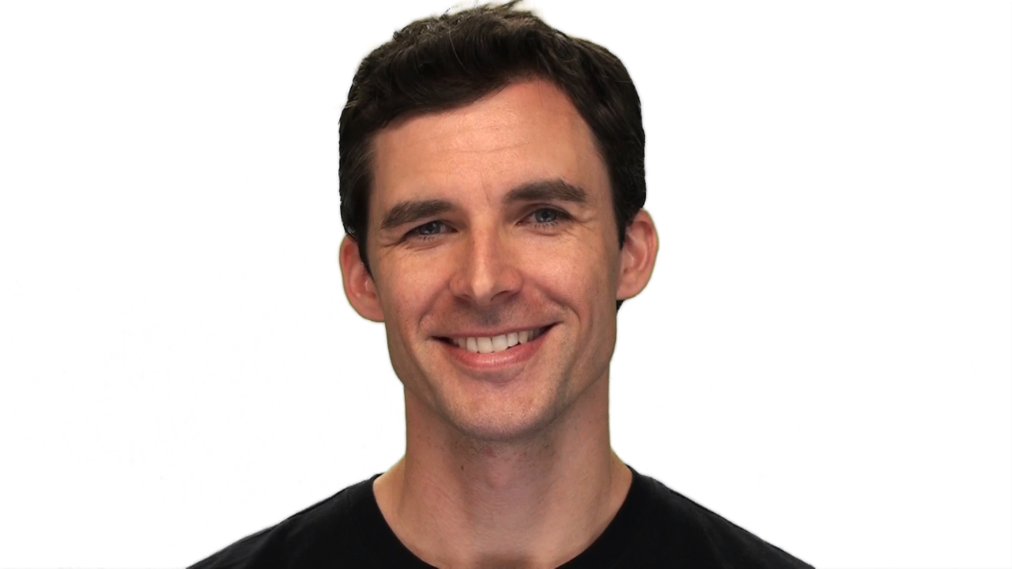
Sample Video-Audio File

Slide 12
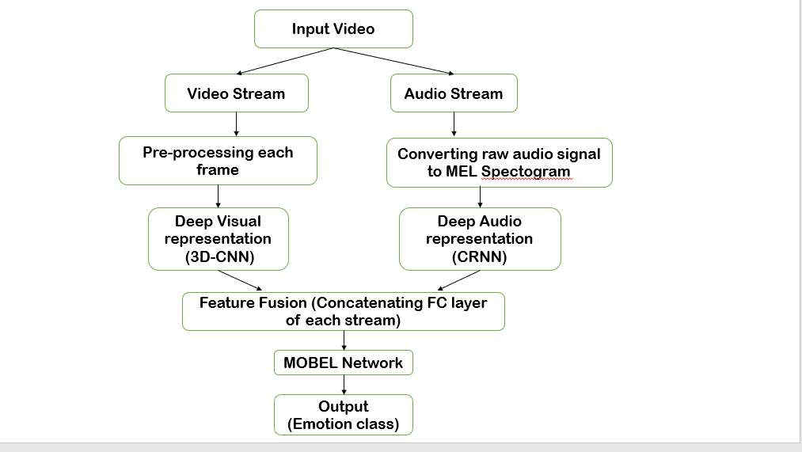
WORK FLOW

Slide 13
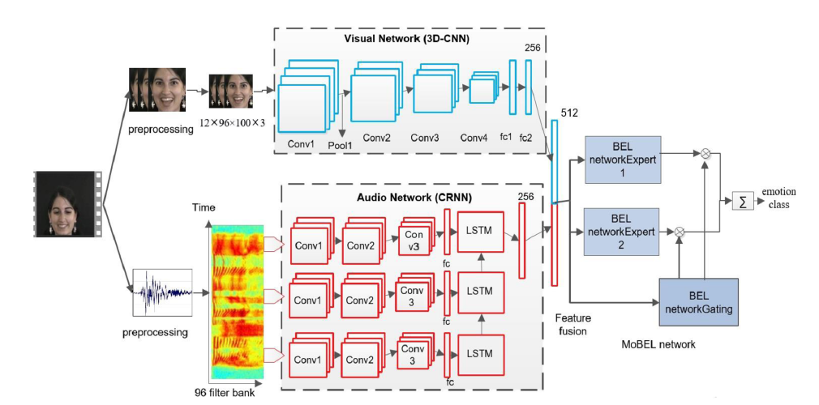
REFERENCE: BASE PAPER

Slide 14
MODULES
MODULE 1(30%):
Preprocessing Audio files
Preprocessing video files
MODULE 2(60%)
Extracting features from Visual modality(3D-CNN)
Extracting features from Audio modality(CRNN)
MODULE 3(100%)
Feature Fusion
Creation of MOBEL network

Slide 15
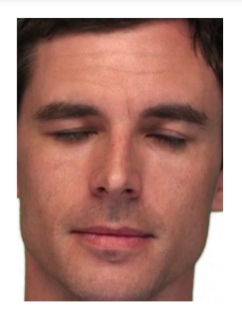
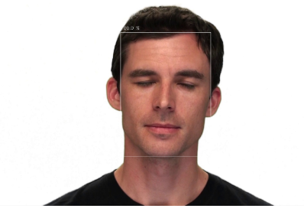
SSD- RESNET
INPUT
OUTPUT

Slide 16
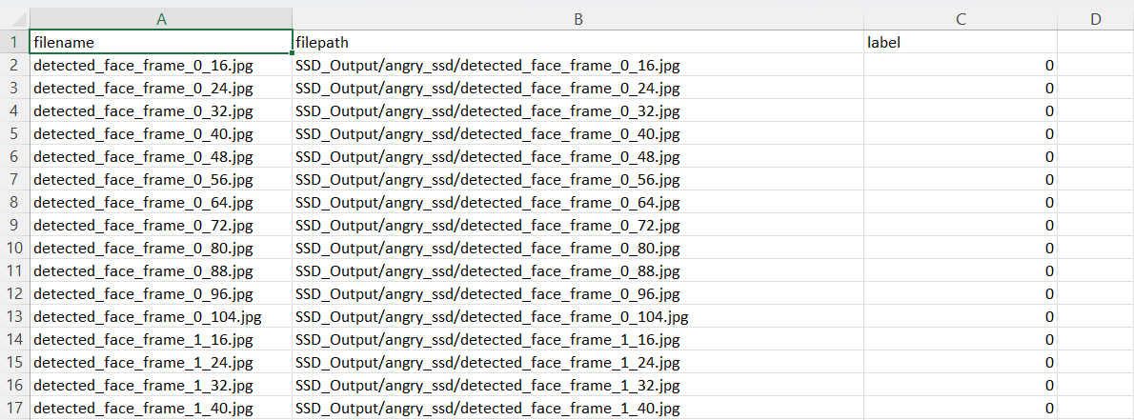
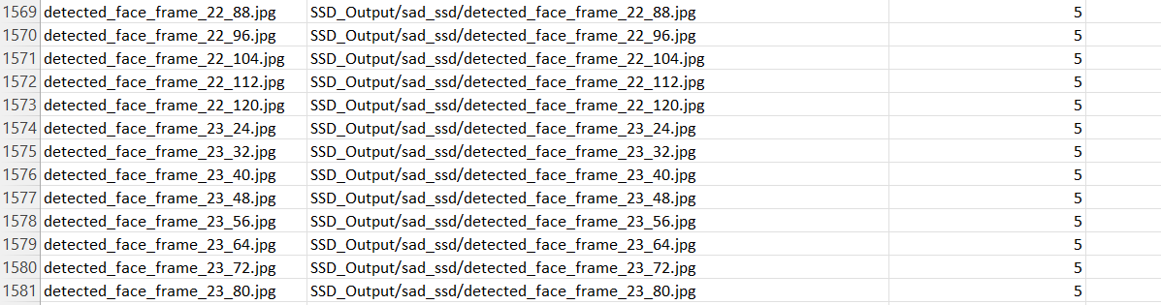
SSD_images.csv:

Slide 17
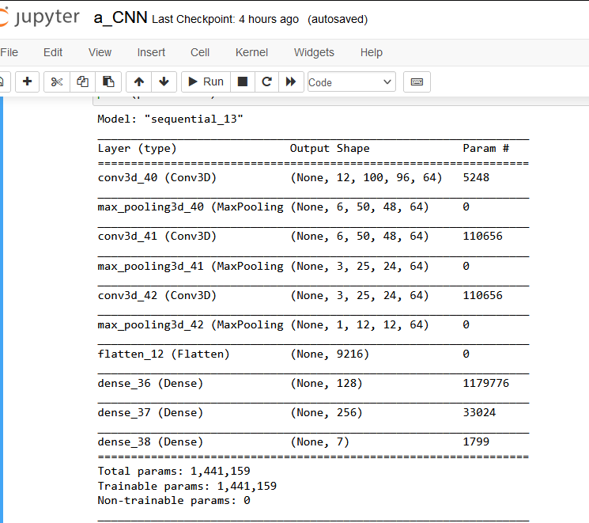
Extracting features from Video files using 3DCNN
. A 3D CNN model was built using Tensorflow and keras library.
. The key frames were fed into the model and 256 features were extracted.
. The model was also trained and tested giving a test accuracy of 94.87%

Slide 18
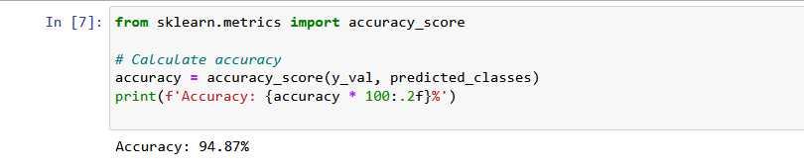
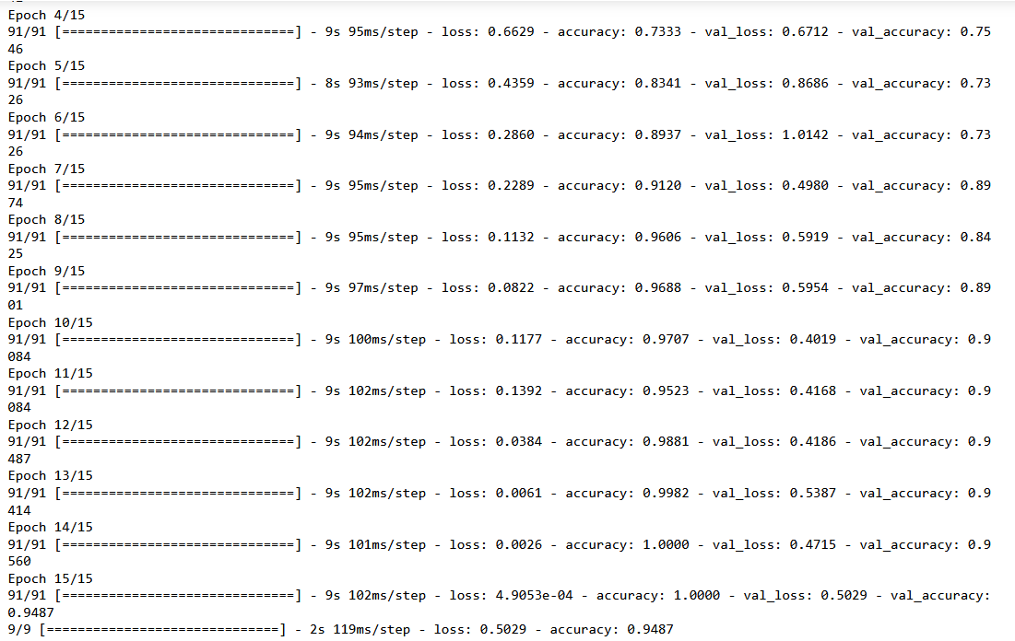
Accuracy :

Slide 19
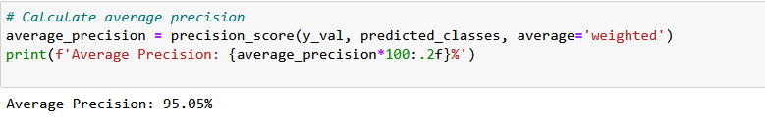
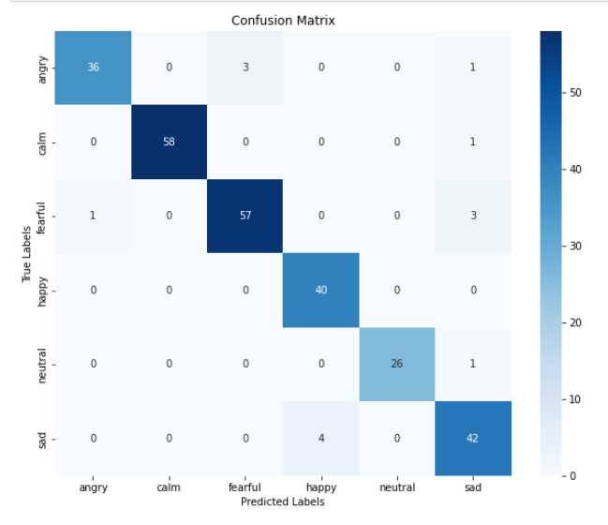
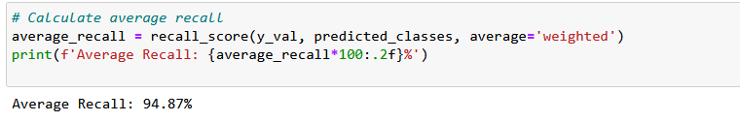
Precision , Recall , Confusion Matrix :

Slide 20

SEGMENTED AUDIO
Segment_2_16_actor1.wav
Segment_3_16_actor1.wav
Segment_4_16_actor1.wav

Slide 21
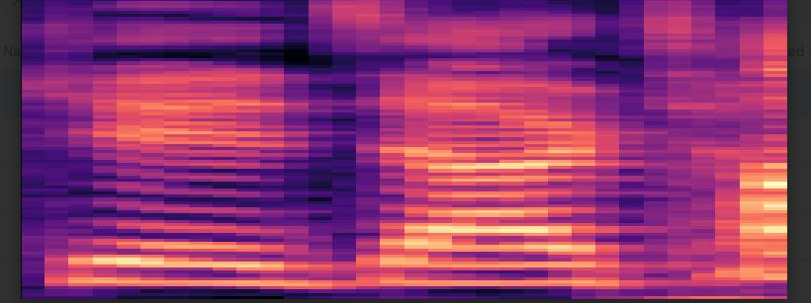
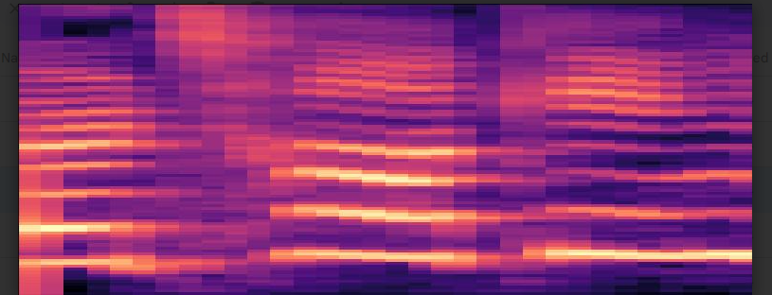
Mel-Spectrogram:
Emotion: HAPPY
Emotion: SAD

Slide 22
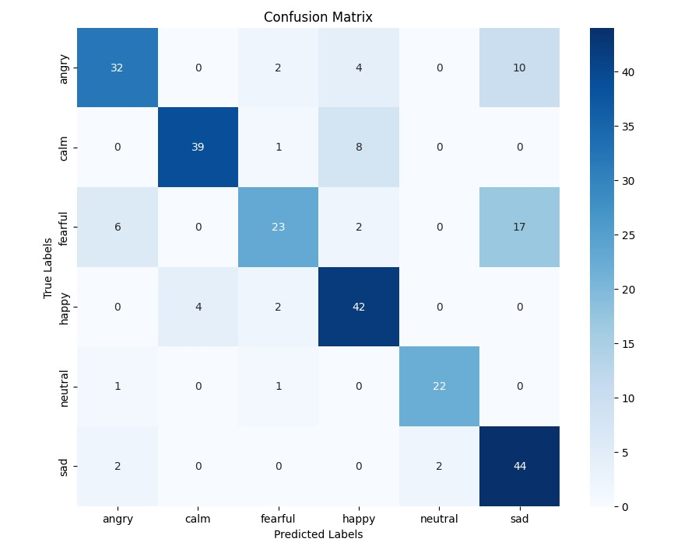
Extracting features from AUDIO files using CRNN
. A CRNN model was built using Tensorflow and keras library.
. The Mel spectrograms were fed into the model and 256 features were extracted.
. The model was also trained and tested giving a test accuracy of 76%

Slide 23
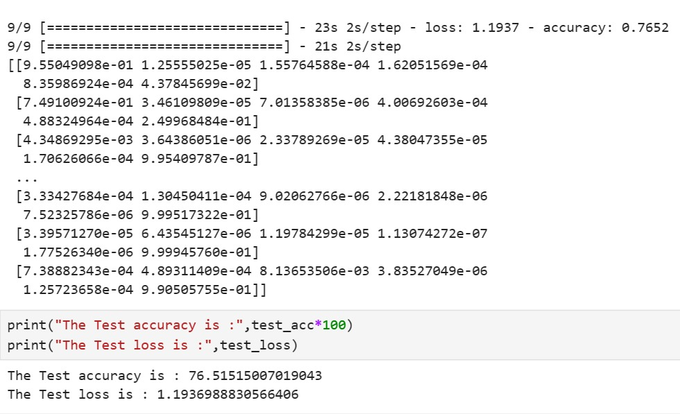
Accuracy, Precision, Recall :

Slide 24
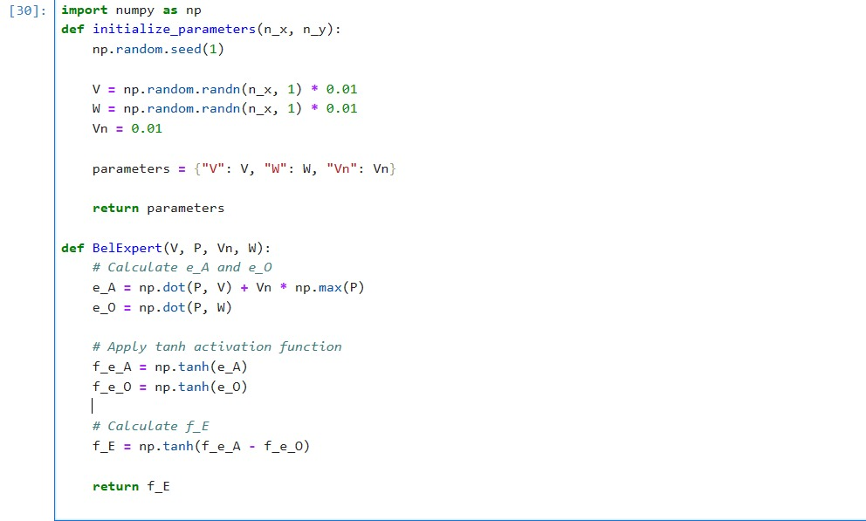
DECISION FUSION BEL MODEL

Slide 25
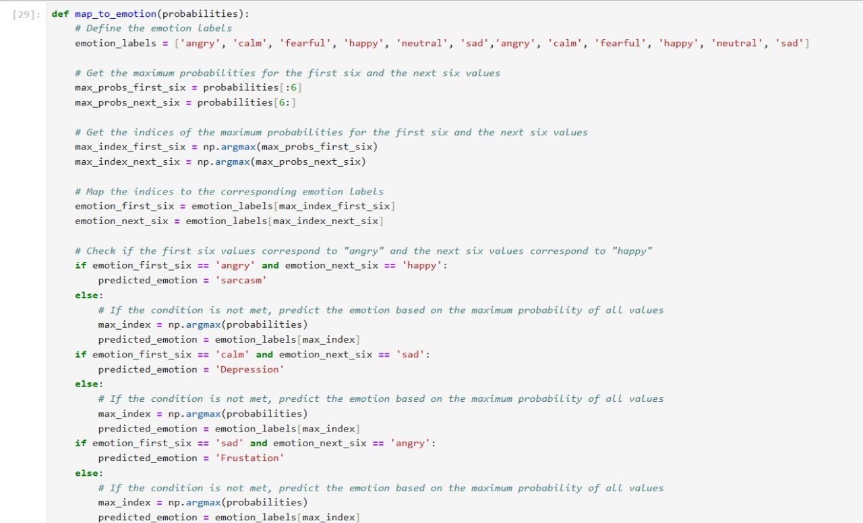

Slide 26
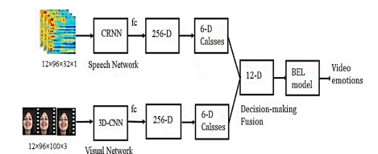
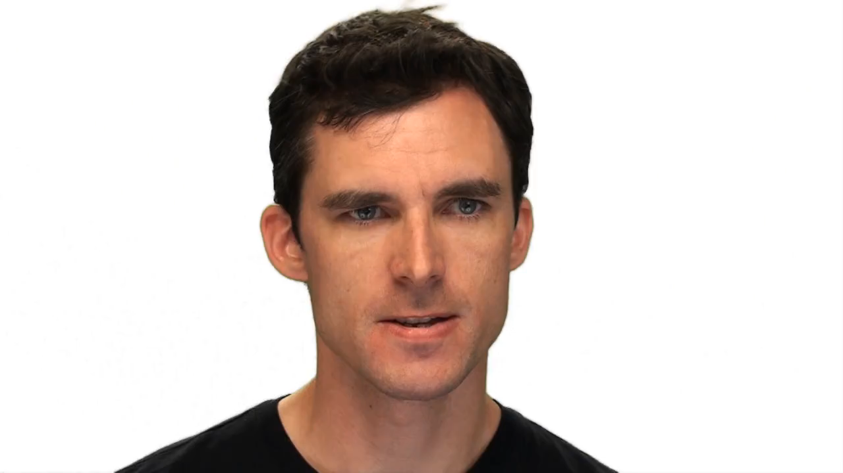
REFERENCE: BASE PAPER
Emotion: HAPPY
Emotion: ANGRY

Slide 27
EMOTION COMBINATIONS
VIDEO | AUDIO | EMOTION
ANGRY | HAPPY | FRUSTRATION
HAPPY | ANGRY | SARCASM
CALM | SAD | DEPRESSION
SAD | FEAR | ANXIETY
HAPPY | FEAR | SUPRISE

Slide 28
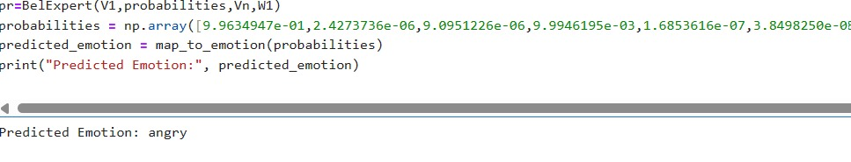
MOBEL MODEL PREDICTIONS
DECISION LEVEL FUSION
The output from the 3D-CNN SoftMax layer and CRNN SoftMax layer is concatenated and passed into the BEL model with weights for AMG and OFC initialized then the gating network is used to predict the emotions.

Slide 29
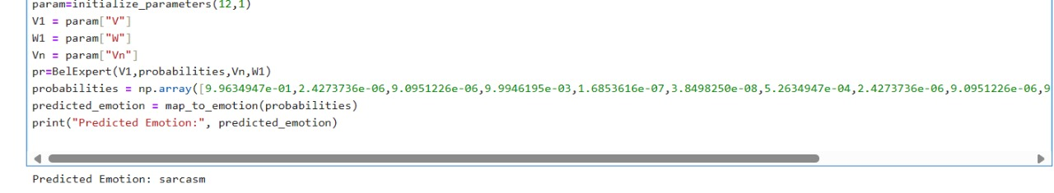
NOVELTY : Conditional BEL
The output from the 3D-CNN SoftMax layer and CRNN SoftMax layer is concatenated and passed into the BEL model with weights for AMG and OFC initialized then the gating network is used to predict the emotions. Here the probabilities from BEL is passed to a condition where checked for combination of emotions and the combined emotions like Sarcasm, Frustration, Depression.

Slide 30
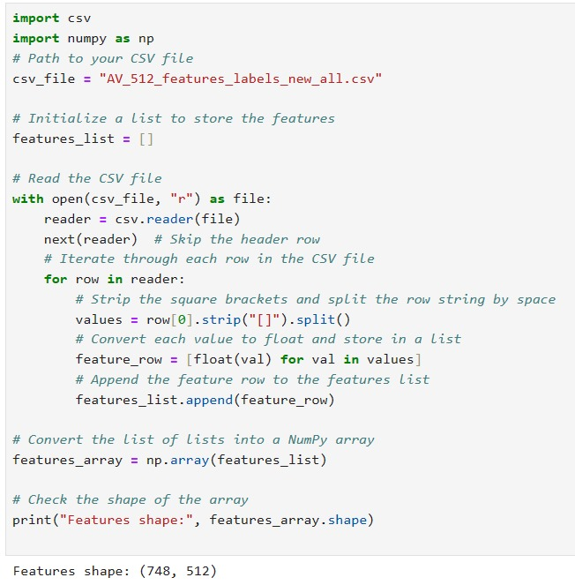
FEATURE FUSION

Slide 31
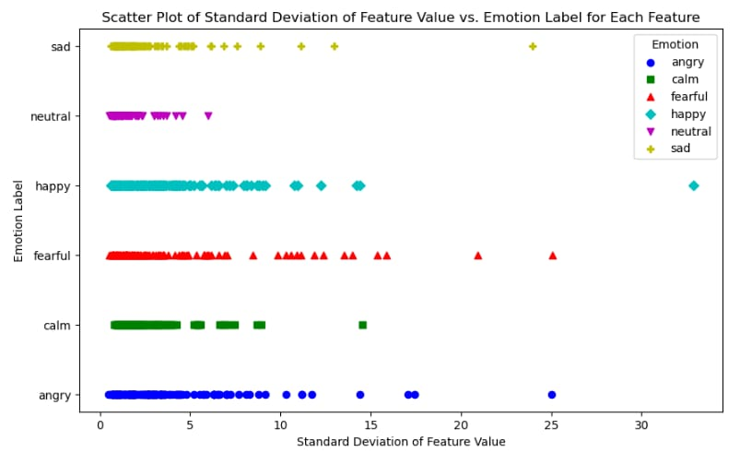

Slide 32
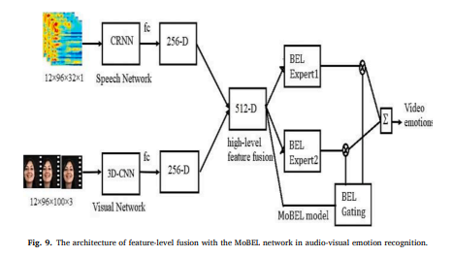
Feature Level Fusion :

Slide 33
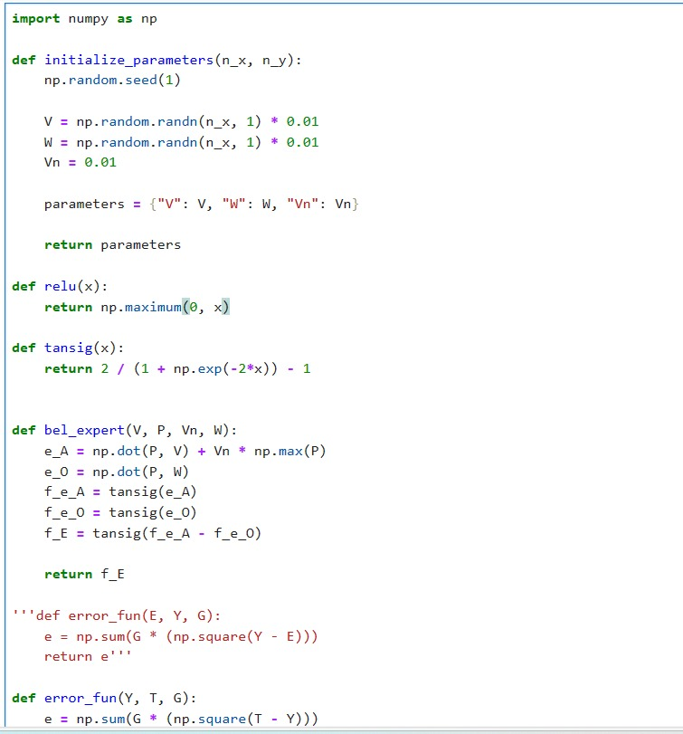
Feature Level Fusion MOBEL:

Slide 34
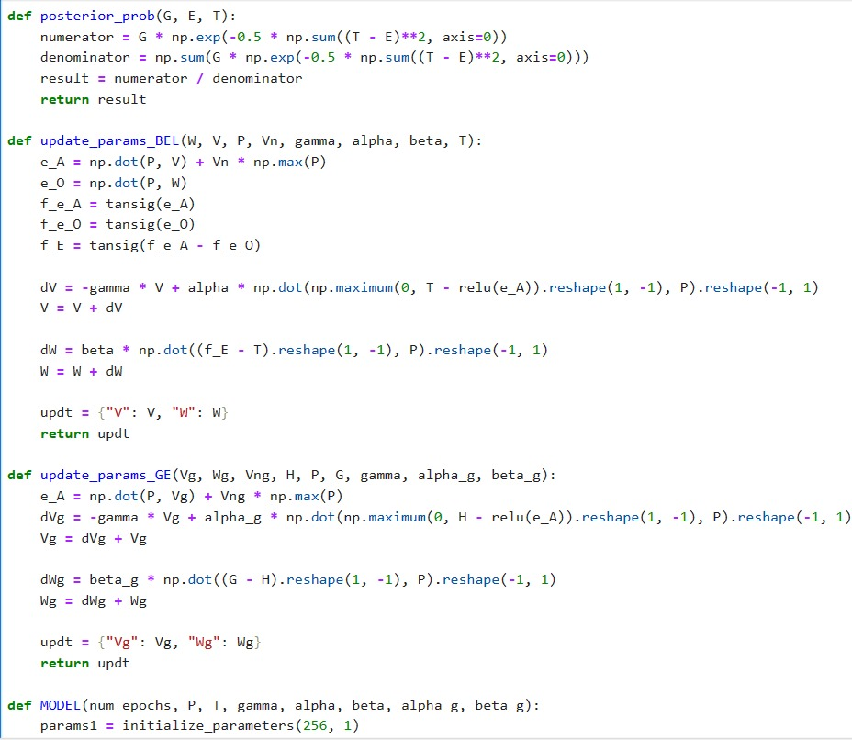

Slide 35
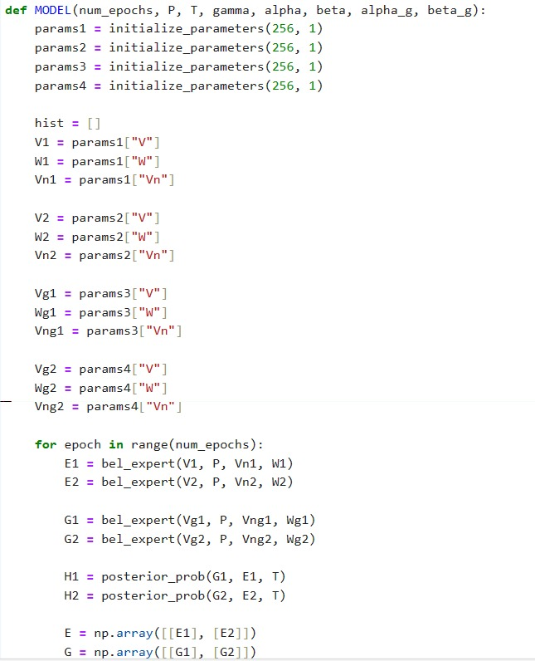

Slide 36
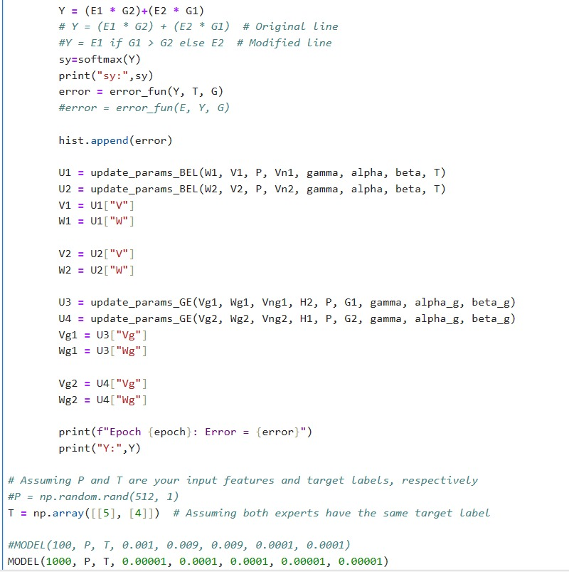

Slide 37
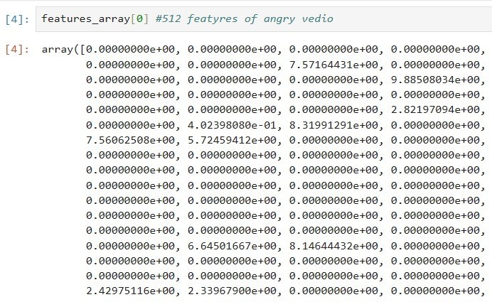
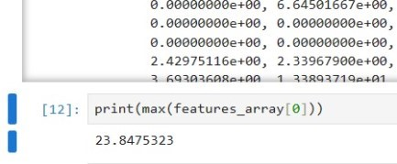
FEATURE SELECTION
MAX feature of a single video
512 features for a single video

Slide 38
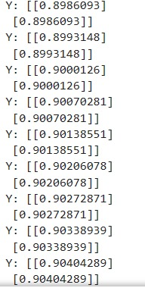
PERFORMANCE of MOBEL

Slide 39
REFERENCES
1.Zhang, S., Zhang, S., Huang, T., Gao, W. and Tian, Q., 2017. Learning affective features with a hybrid deep model for audio–visual emotion recognition. IEEE Transactions on Circuits and Systems for Video Technology, 28(10), pp.3030-3043.
2. Zhao, J., Lin, C.M. and Chao, F., 2019. Wavelet fuzzy brain emotional learning control system design for MIMO uncertain nonlinear systems. Frontiers in neuroscience, 12, p.918.
3. Zeng, Z., Tu, J., Pianfetti, B., & Huang, T., 2008. Audio–Visual Affective Expression Recognition Through Multistream Fused HMM. IEEE Transactions on Multimedia, 10, pp. 570-577.
4. Tran, D., Bourdev, L., Fergus, R., Torresani, L., & Paluri, M., 2014. Learning Spatiotemporal Features with 3D Convolutional Networks. 2015 IEEE International Conference on Computer Vision (ICCV), pp. 4489-4497.
5. Lim, W., Jang, D. and Lee, T., 2016, December. Speech emotion recognition using convolutional and recurrent neural networks. In 2016 Asia-Pacific signal and information processing association annual summit and conference (APSIPA) (pp. 1-4). IEEE.
6. Ivleva, N., Pentel, A., Dunajeva, O. and Juštšenko, V., 2023, September. Deep Learning Based Audio-Visual Emotion Recognition in a Smart Learning Environment. In International Conference on Interactive Collaborative Learning (pp. 420-431). Cham: Springer Nature Switzerland.

Slide 40
7. Wang, X., Chen, X. and Cao, C., 2020. Human emotion recognition by optimally fusing facial expression and speech feature. Signal Processing: Image Communication, 84, p.115831.
8. Yuvchenko, K., Yesilevskyi, V. and Sereda, O., 2022. HUMAN EMOTION RECOGNITION SYSTEM USING DEEP LEARNING ALGORITHMS. Innovative Technologies and Scientific Solutions for Industries, (3 (21)), pp.60-69.
9. Baird, A., Amiriparian, S., Milling, M. and Schuller, B.W., 2021, January. Emotion recognition in public speaking scenarios utilising an lstm-rnn approach with attention. In 2021 IEEE Spoken Language Technology Workshop (SLT) (pp. 397-402). IEEE.
10. Said, Y. and Barr, M., 2021. Human emotion recognition based on facial expressions via deep learning on high-resolution images. Multimedia Tools and Applications, 80(16), pp.25241-25253.
11. Mustaqeem, K., El Saddik, A., Alotaibi, F.S. and Pham, N.T., 2023. AAD-Net: Advanced end-to-end signal processing system for human emotion detection & recognition using attention-based deep echo state network. Knowledge-Based Systems, 270, p.110525.
12. Mancini, E., Galassi, A., Ruggeri, F. and Torroni, P., 2024. Disruptive situation detection on public transport through speech emotion recognition. Intelligent Systems with Applications, 21, p.200305.

Slide 41
THANK YOU !!

